Slide 1
PROCESS SERVER
INSTALATION

Slide 2
AGENDA
Install Process Server
Cleanse and Match Server

Slide 3
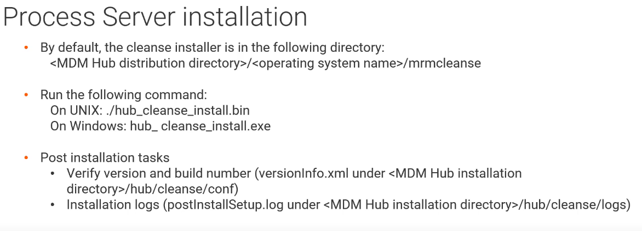
PROCESS SERVER
.

Slide 4
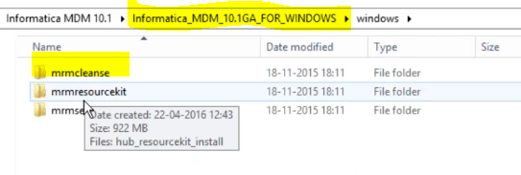
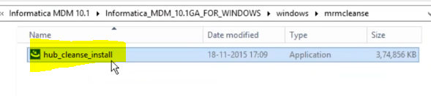
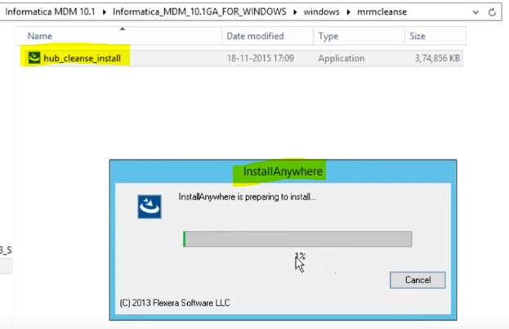
PROCESS SERVER
Once you download MDM software, Process Server Installation file will be in “MRMCLEANSE” folder.
Inside “MRMCLEANSE” folder, you will get ‘hub_cleanse_install’ executable file.

Slide 5
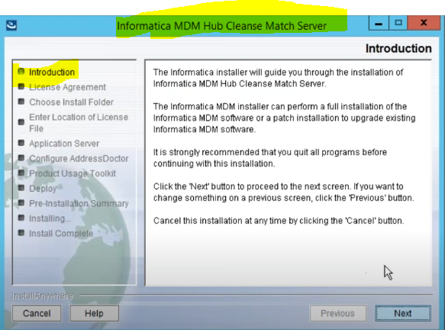
PROCESS SERVER
Installation starts.

Slide 6
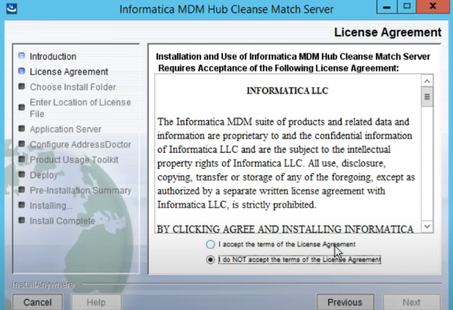
PROCESS SERVER
Accept the License and Agreement.

Slide 7
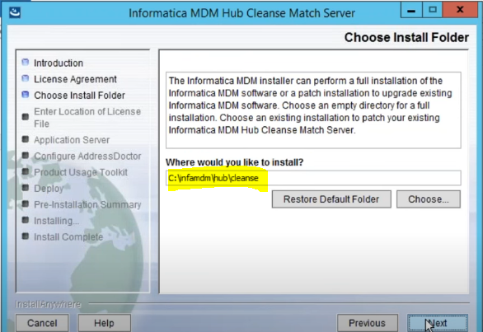
PROCESS SERVER
Select Install Folder.

Slide 8
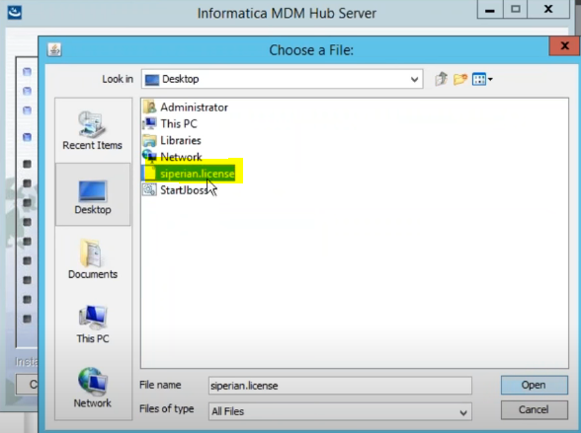
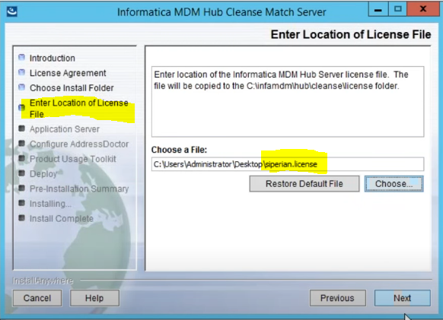
PROCESS SERVER
Select License File which you will get from Informatica
Same License will be used, that we use for Hub Server Installation

Slide 9
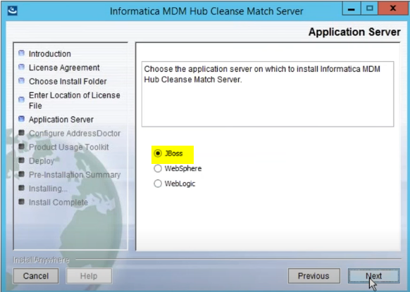
PROCESS SERVER
Select Application Server.

Slide 10
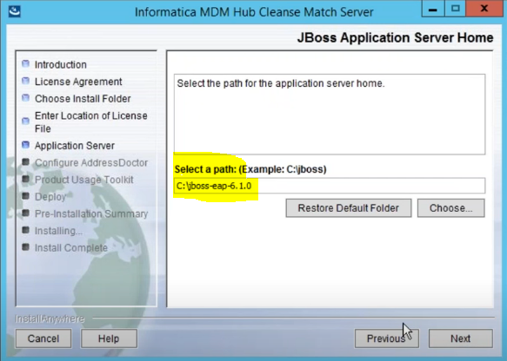
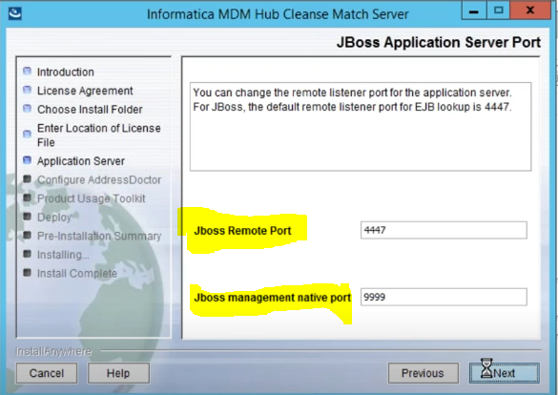
PROCESS SERVER
Select Application Server path.
Provide Port Information.

Slide 11
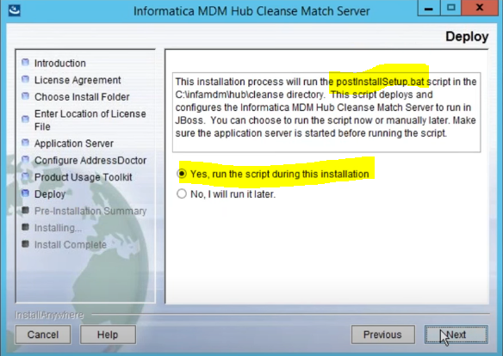
PROCESS SERVER
Select YES for postInstallation.sh script.
This will resolve if any error occur during installation.

Slide 12
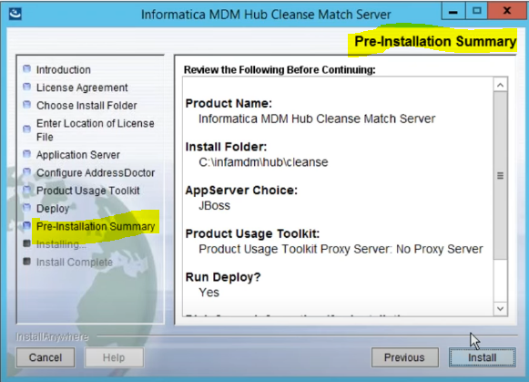
PROCESS SERVER
Pre-Installation Summary

Slide 13
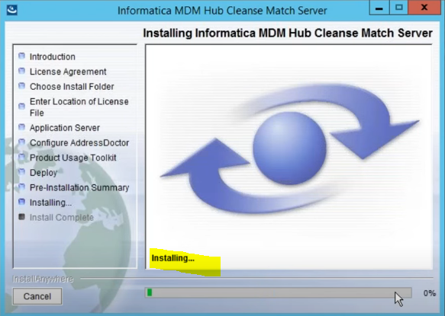
PROCESS SERVER
Installation Process Starts

Slide 14
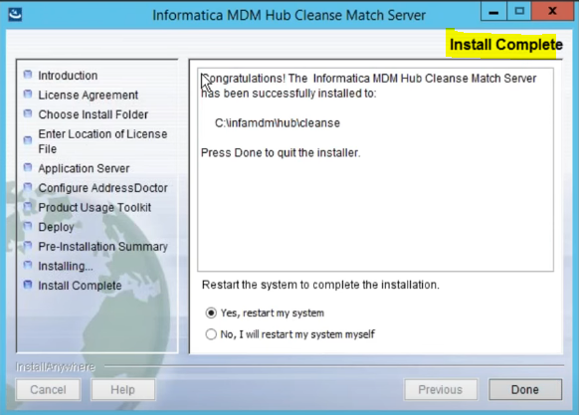
PROCESS SERVER
Installation Completed.

Slide 15
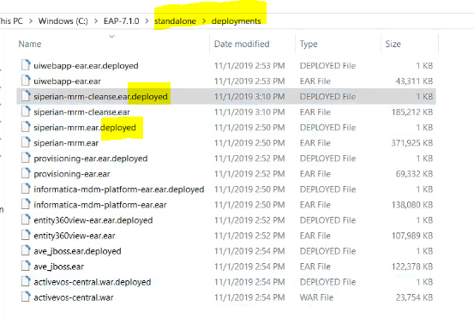
PROCESS SERVER
Check Deployment folder to see what all component got installed.

Slide 16
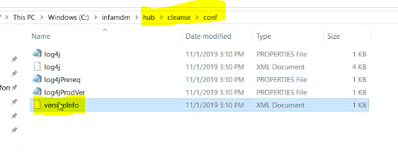
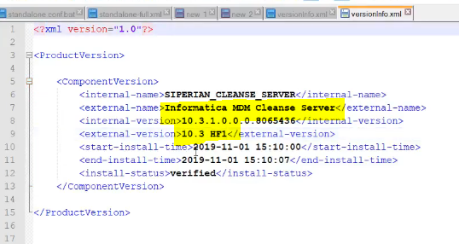
PROCESS SERVER
Check versioninfo
PATH: Hub → Cleasne → conf
File: versioninfo

Slide 17
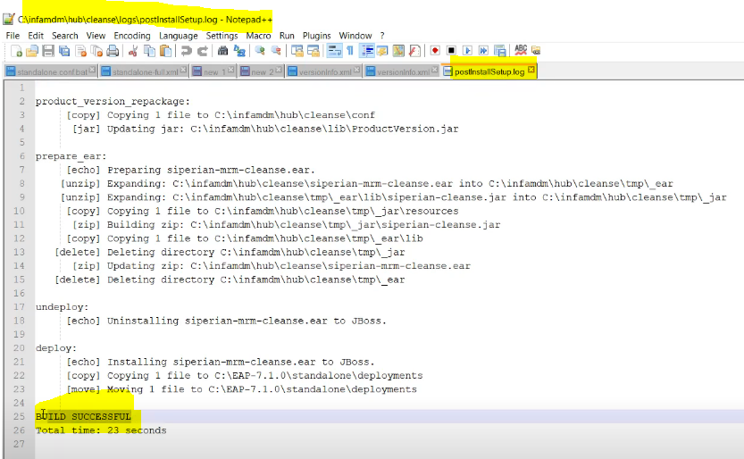
PROCESS SERVER
Post Install Setup Log
PATH: Hub → Cleanse → Log
File: PostInstallSetup.log

